Slide 1

West Region Next Steps

Slide 2
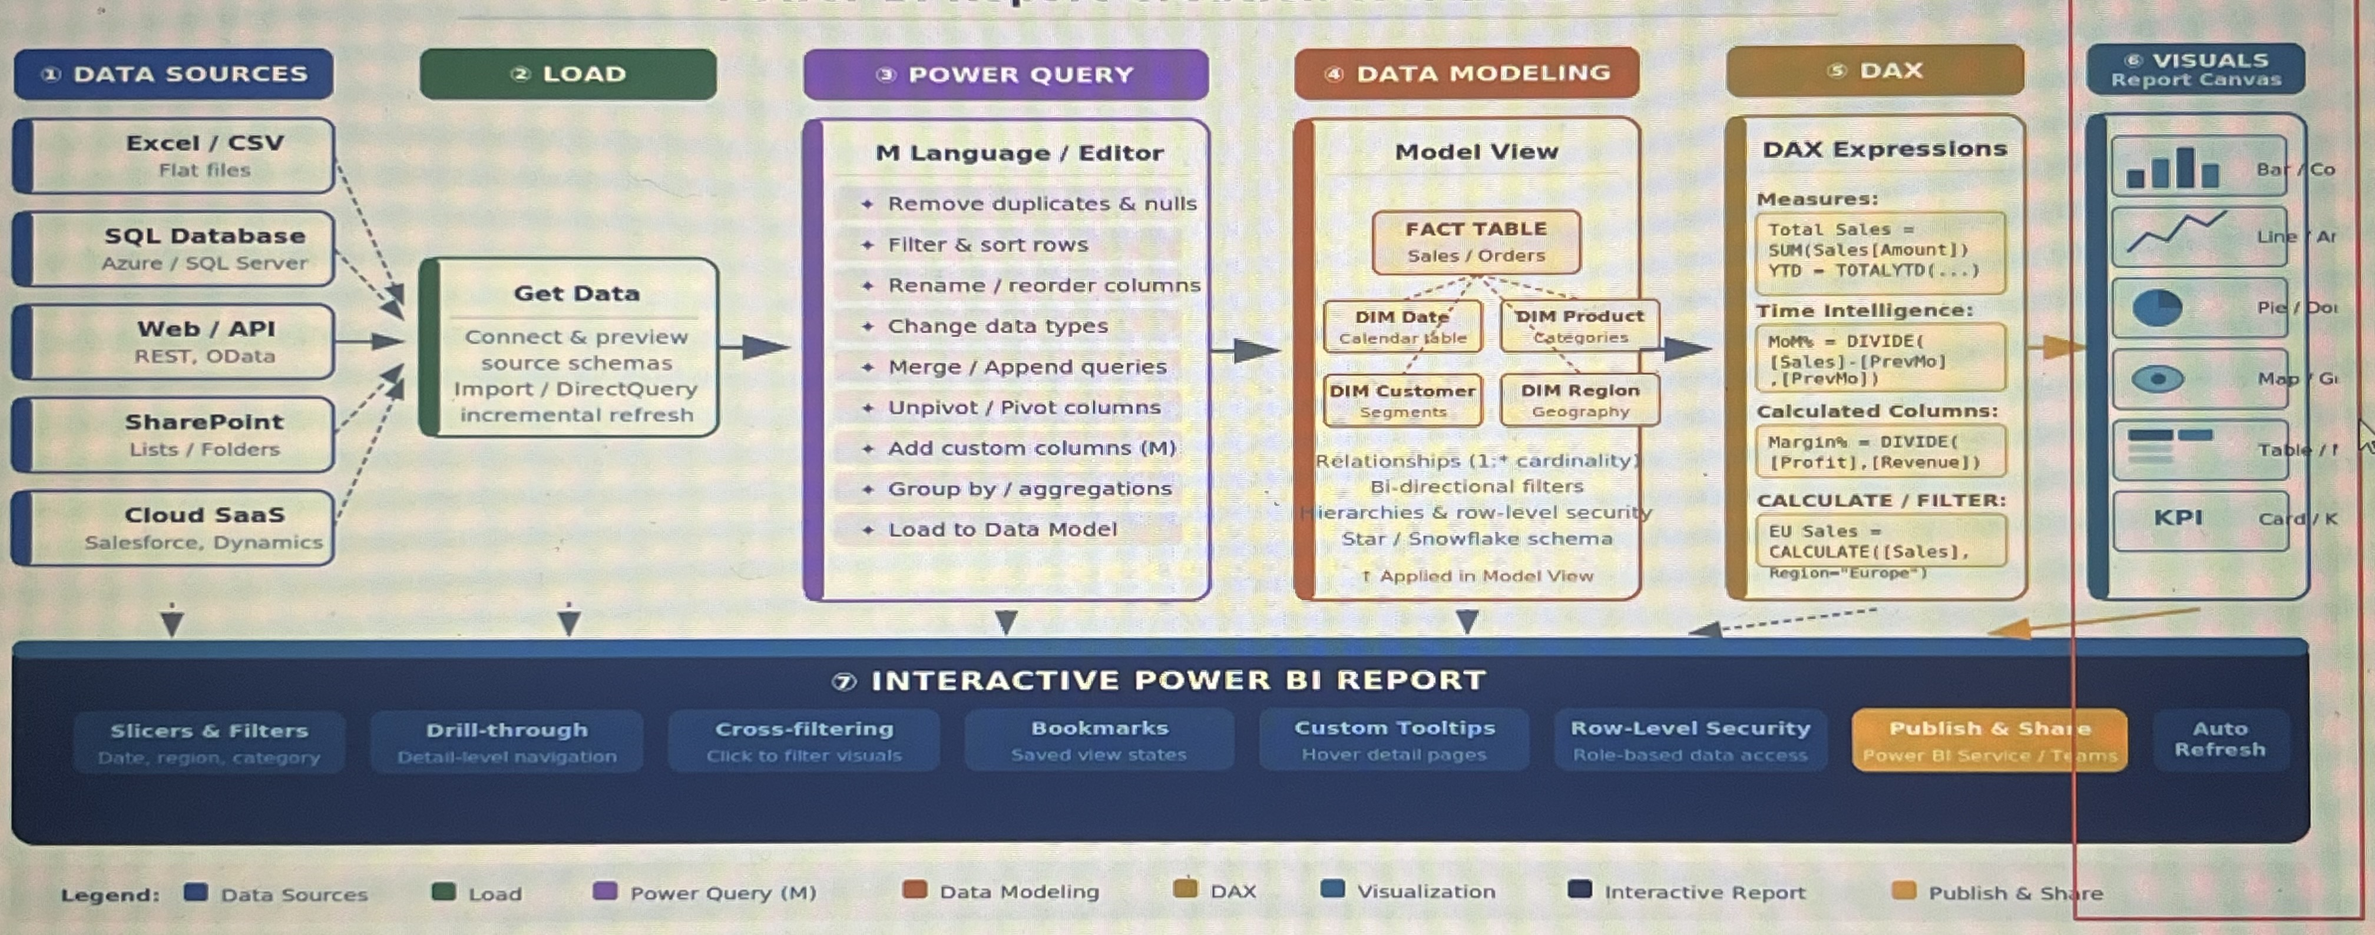
Planning
Introduction
Growth
Sales & Trends
Performance
Final tips & takeaways

Slide 3
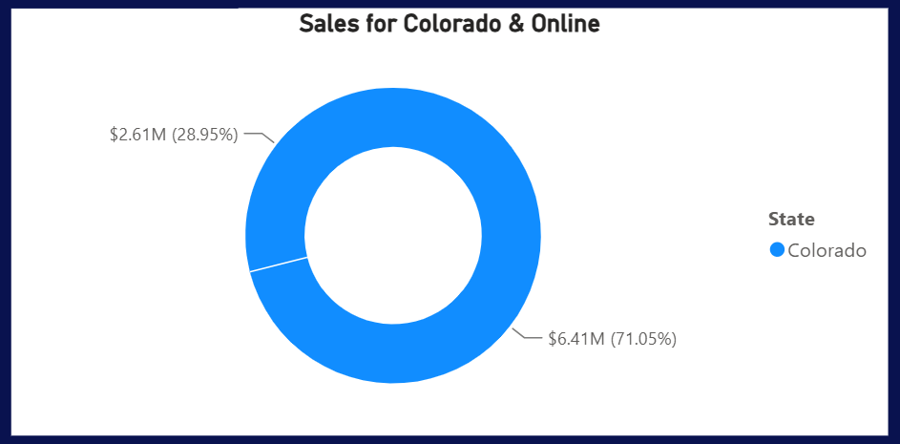
Total West Region Sales
Region: West
State: Colorado & Online Sales
In-Store Sales: $6.41M
Online Sales: $2.6M

Slide 4
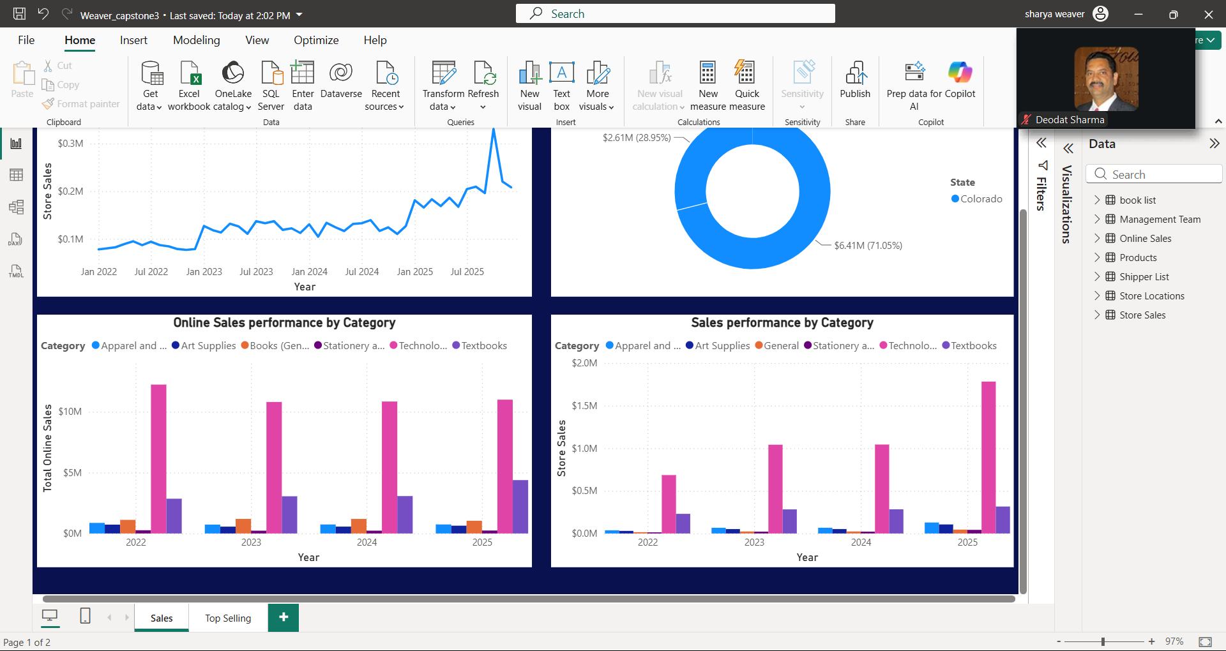
Growth
For the past few years, the categories that have been dominating the west region are technologies & accessories, with textbooks coming in second by a huge gap.

Slide 5
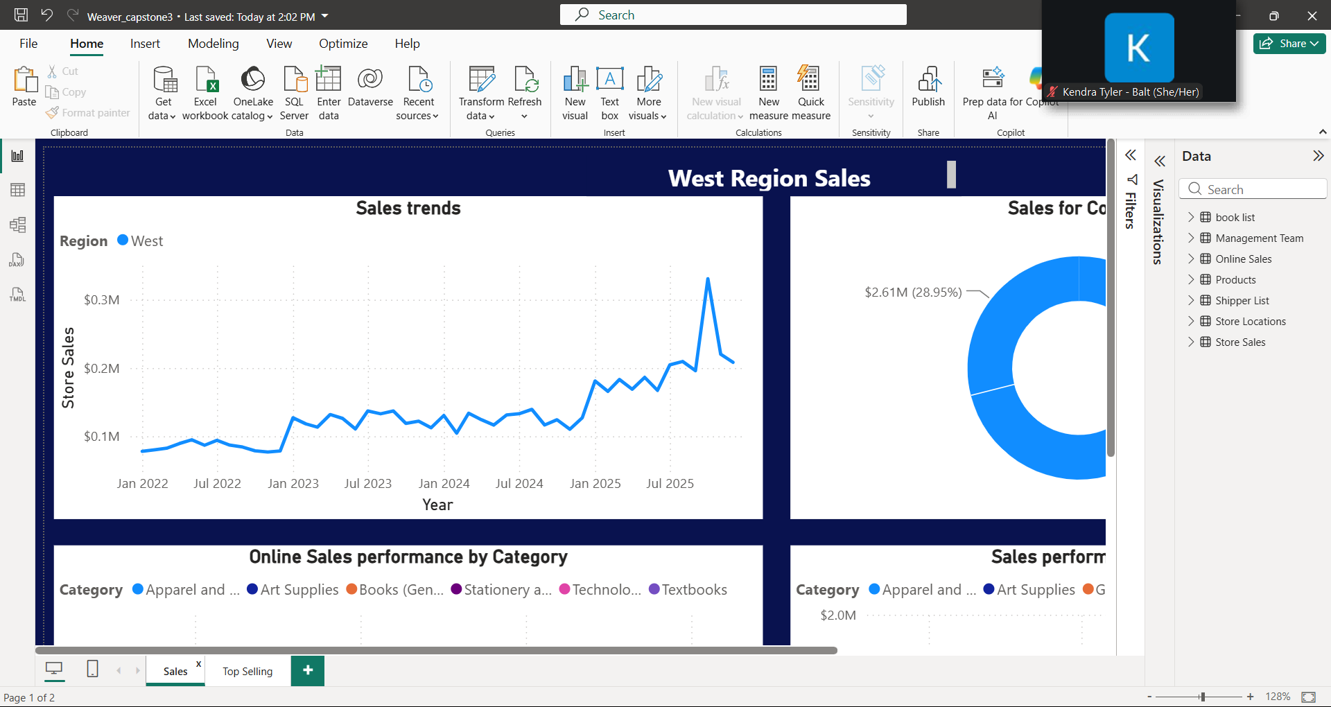

Sales & Trends
Steadily moving ascending through the years. Our highest point was in October with 330k for in-store sales.
As of December, sales seem to have dropped to 208k. We can make a few assumptions based on the weather and the seasonal time.

Slide 6
Books Performance
Top-selling authors are:
Suzanne Collins - $ 38,652.65
Stephen Hawkings - $37,844.04
J.K. Rowling - $31, 961.04
We should focus our inventory mostly on books from these authors since they are producing the most sales within our stores.
With that, our sales won’t rely mainly on the technology & accessories, which is rather dangerous.

Slide 7

Final Tips & Takeaways
We can at most predict when certain sales may drop from certain products based on the time and season. We should base our marketing on that.
Colorado stores experienced a 12% decline in Category textbook and books sales during the last year, while online sales for the same category remained stable. Management should consider targeted online promotions to help increase demand and offset declining in-store performance.

Slide 8
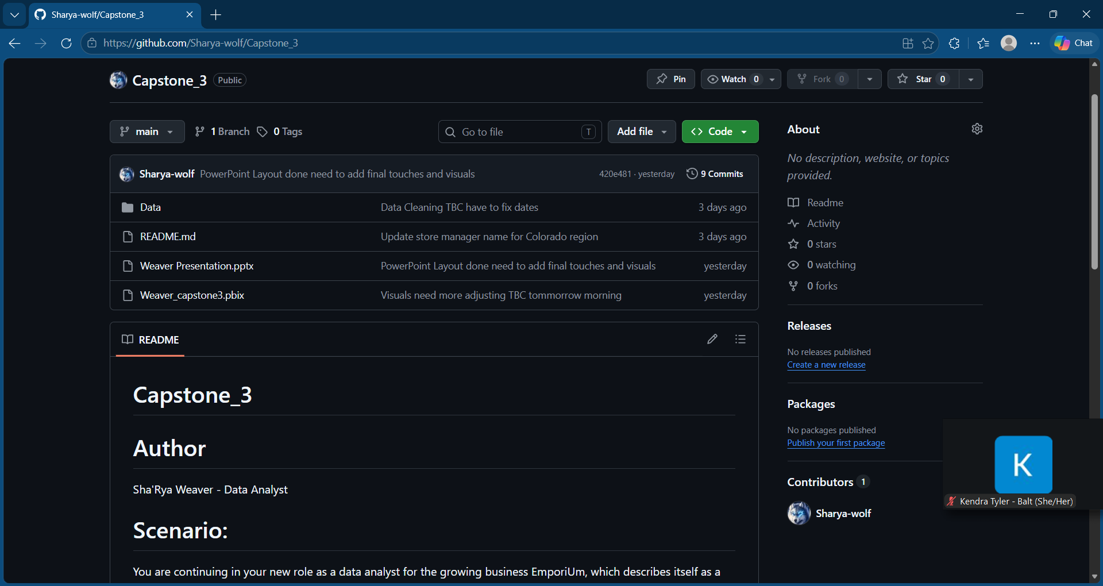
Git Hub & Power BI Links
https://github.com/Sharya-wolf/Capstone_3.git
Weaver's Power BI Link

Slide 9

Thank you!

